Slide 1
Task 2. ISO 9241
Jose Collado San Pedro
#5
9.4.12 Provide adjustment of pointer movement direction
8.1.2 Enable switching of input/output alternatives
8.2.7 Provide text label display option for icons

Slide 2
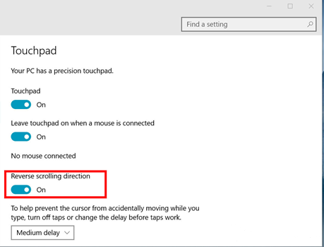
9.4.12 : Provide adjustment of pointer movement direction
Software that uses a pointing device input should allow to the users to adjust the direction at which the pointer moves in response to a movement of the pointing device.
For example, the opposite or perpendicular to the pointing movement direction.
This is useful for people with movement limitations.
Windows 10 settings

Slide 3
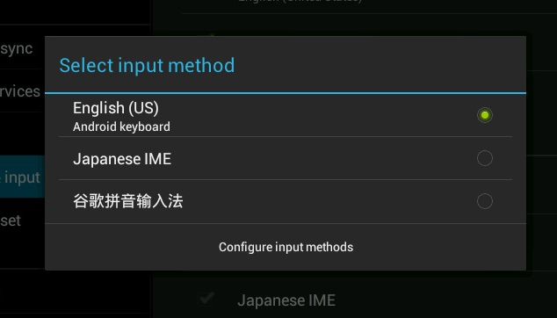
8.1.2 Enable switching of input/output alternatives
Platform software allows users to switch input/output alternatives without reconfigure or restart the system or applications.
For example, a computer is used by a blind person and a sighted person. They must be able to change between different input alternatives without restart the system.
Android input method selector

Slide 4
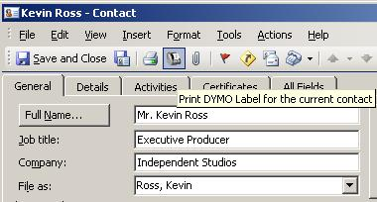
8.2.7 Provide text label display option for icons
Every icon provided by software should have an associated text label and the user should be given the option of choosing between displaying only the icon image, the icon image with the text label or only the icon text label.
Outlook Interface

